Slide 1


Code Innovation Series - ADGITM
Theme: HEALTHTECH
Team Name: Bit Lords
ML based Health Predictor System

Slide 2
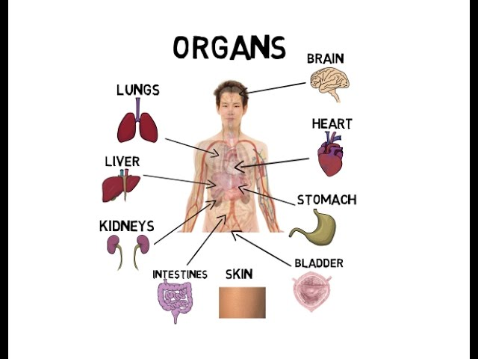
Motivation
Access to quality healthcare and doctors has always been a concern in developing countries and remote areas.
As reported by WHO, heart disease and stroke are the world’s biggest killers.
Patients with Liver disease have been continuously increasing because of excessive consumption of alcohol, inhale of harmful gases, intake of contaminated food, pickles and drugs.
Infected lungs can cause many diseases like pneumonia.

Slide 3

So keeping all this in mind we have designed a software which will predict the user’s health conditions on the basis of medical tests.
So that user can have time to be cautious and prepare for the disease which can be cured or prevented at this stage.

Slide 4

Idea & Approach
Our software consists of ML models for various diseases:
Heart diseases prediction
Liver diseases prediction
Lung diseases prediction
Cancer prediction
Pneumonia
No need to fill details (OCR will detect)
Prediction of diseases at early stages even
when doctors can’t detect.

Slide 5
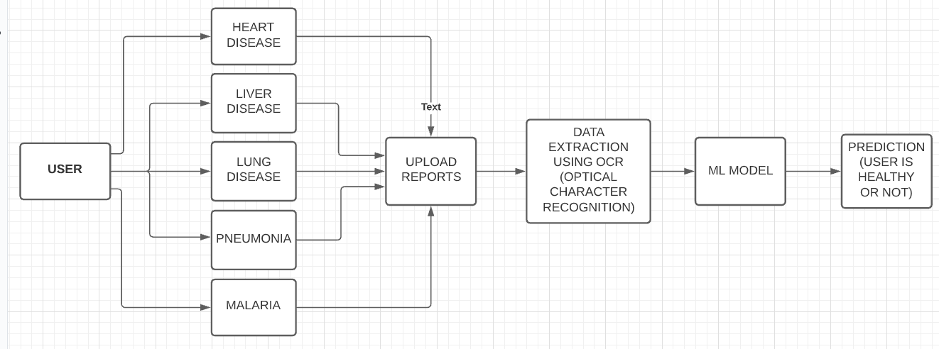
Flow of Control

Slide 6
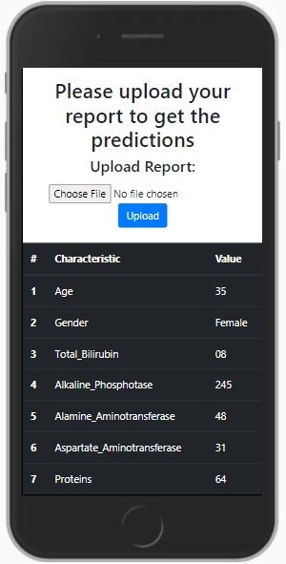
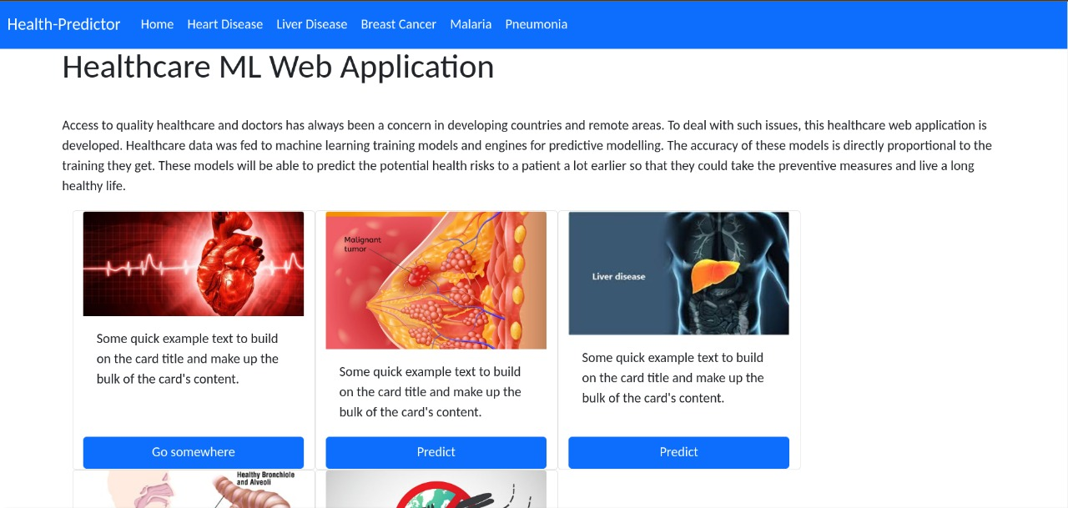
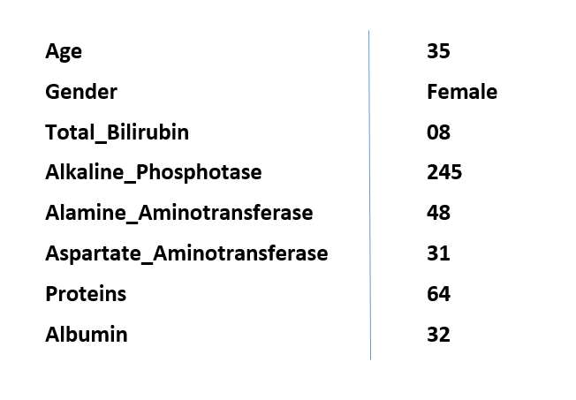

Slide 7

Precaution is better than cure. I think I should consult a specialist right now
REPORT looks fine to me. Don’t worry take these pills, no need to worry.
LAB REPORTS
ML Based Health Predictor System
Predicted: Kidney Cancer
Consult with specialist to treat it at early stages.

Slide 8

Conclusion
We believe that our solution is innovative, user-friendly and have the potential to improve the health sector. It will be beneficial and useful for the users as it also consider the comfort of the users. The solution is based on advance technologies including machine learning. We have read many research papers and this project is made by combining their studies.

Slide 9


